Slide 1

1
CHARACTERIZATION OF SIMULATION
by Lim Xin Yi
PHY2304247
Supervised by Dr. Hoh Siew Yan

Slide 2
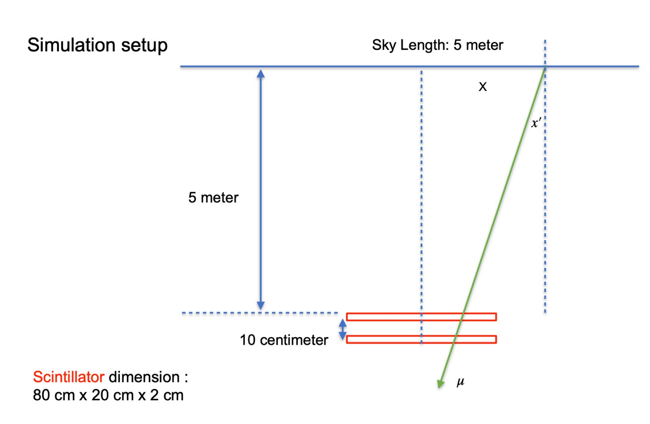
2
Introduction
Goal : Feasibility study on cosmic muon in anomalous density detection, foundation for muography application.
Before achieving the goal , we must remove bias due to finite sky plane
Motivating the study of potential bias in the presence of simulation artifact: Limited sky plane.
Recap of last presentation …
20cm x 40cm x 1cm

Slide 3
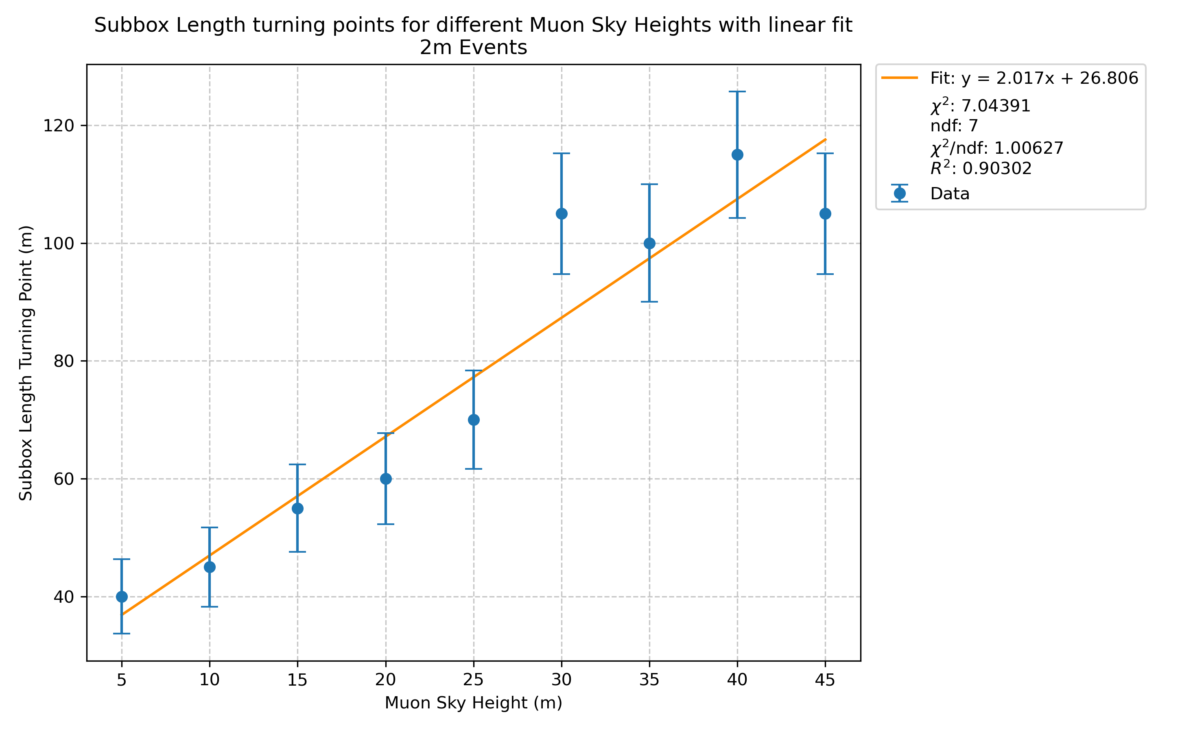
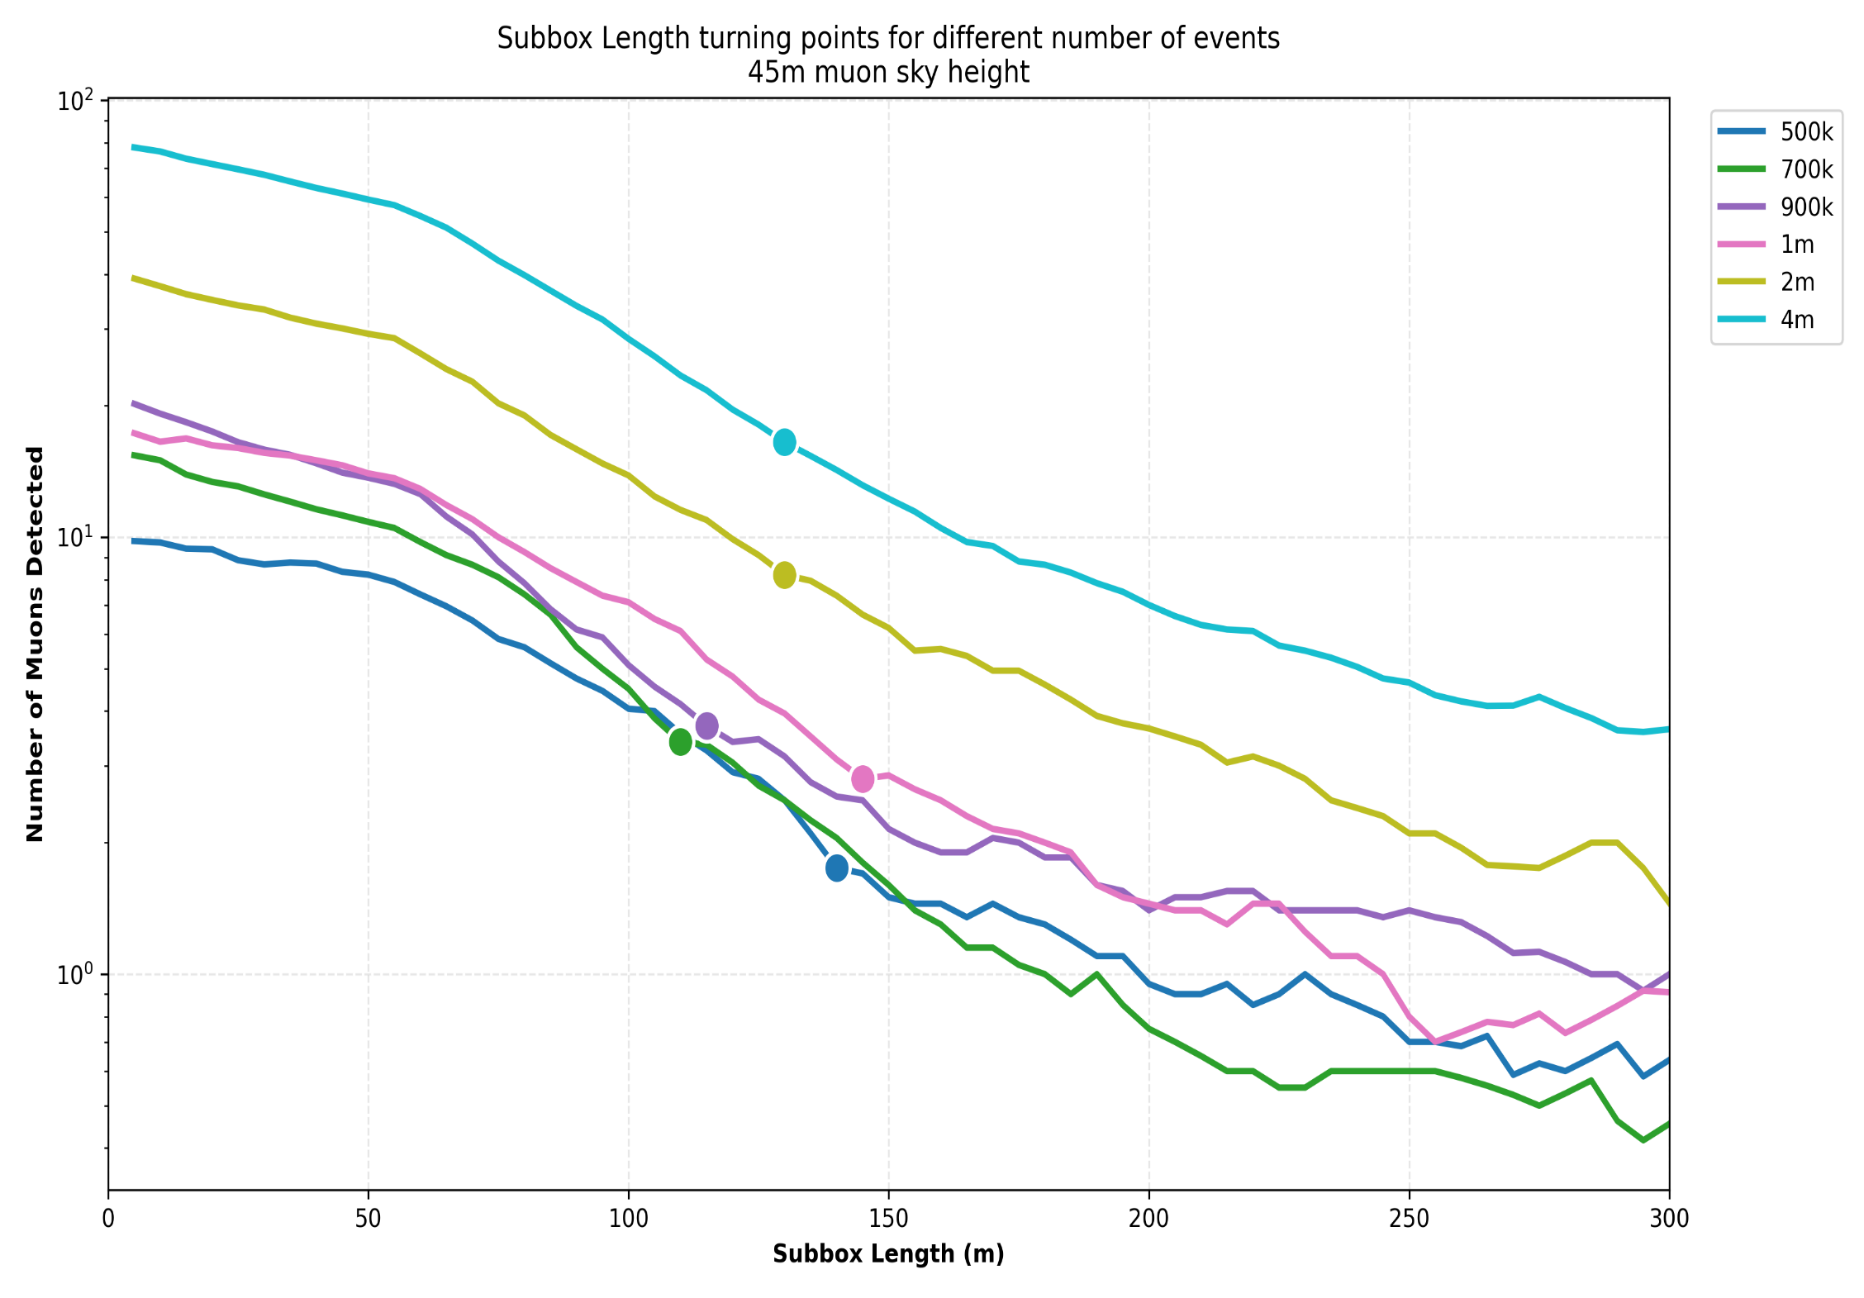
3
Recap
Multiparameter scan
    Is the bias really optimized?
Concluded that
Parameter | Scan range | Scan step
Subbox length | [ 5 , 300 ] m | 5 m
height | [ 5 , 45 ] m | 5 m
Statistics | 500k, 700k, 900k , 1m, 2m, 4m | -
    Optimal parameters : statistics 2m events
    Relation between turning point and height derived
    Approximate turning point and only valid for specific detector
2 million events is needed
130m

Slide 4
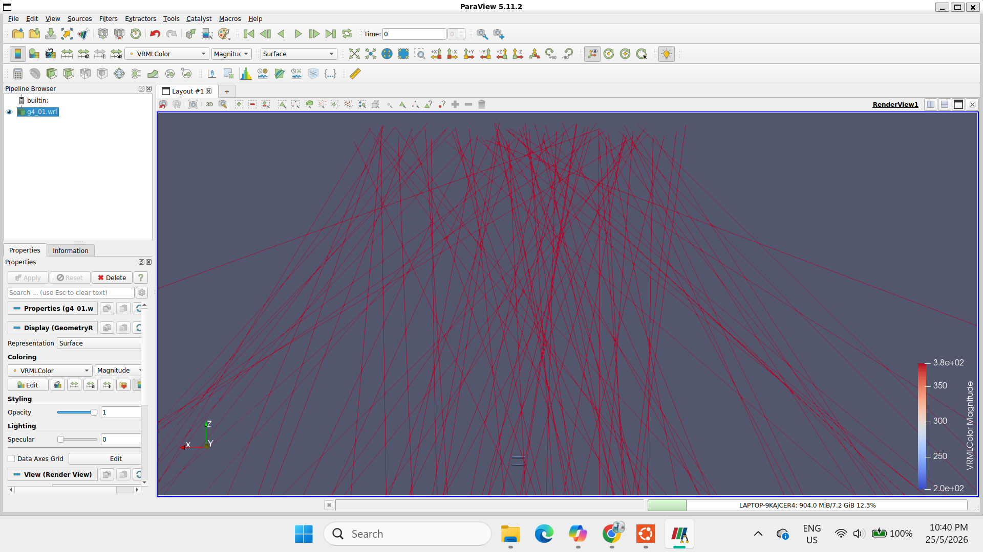
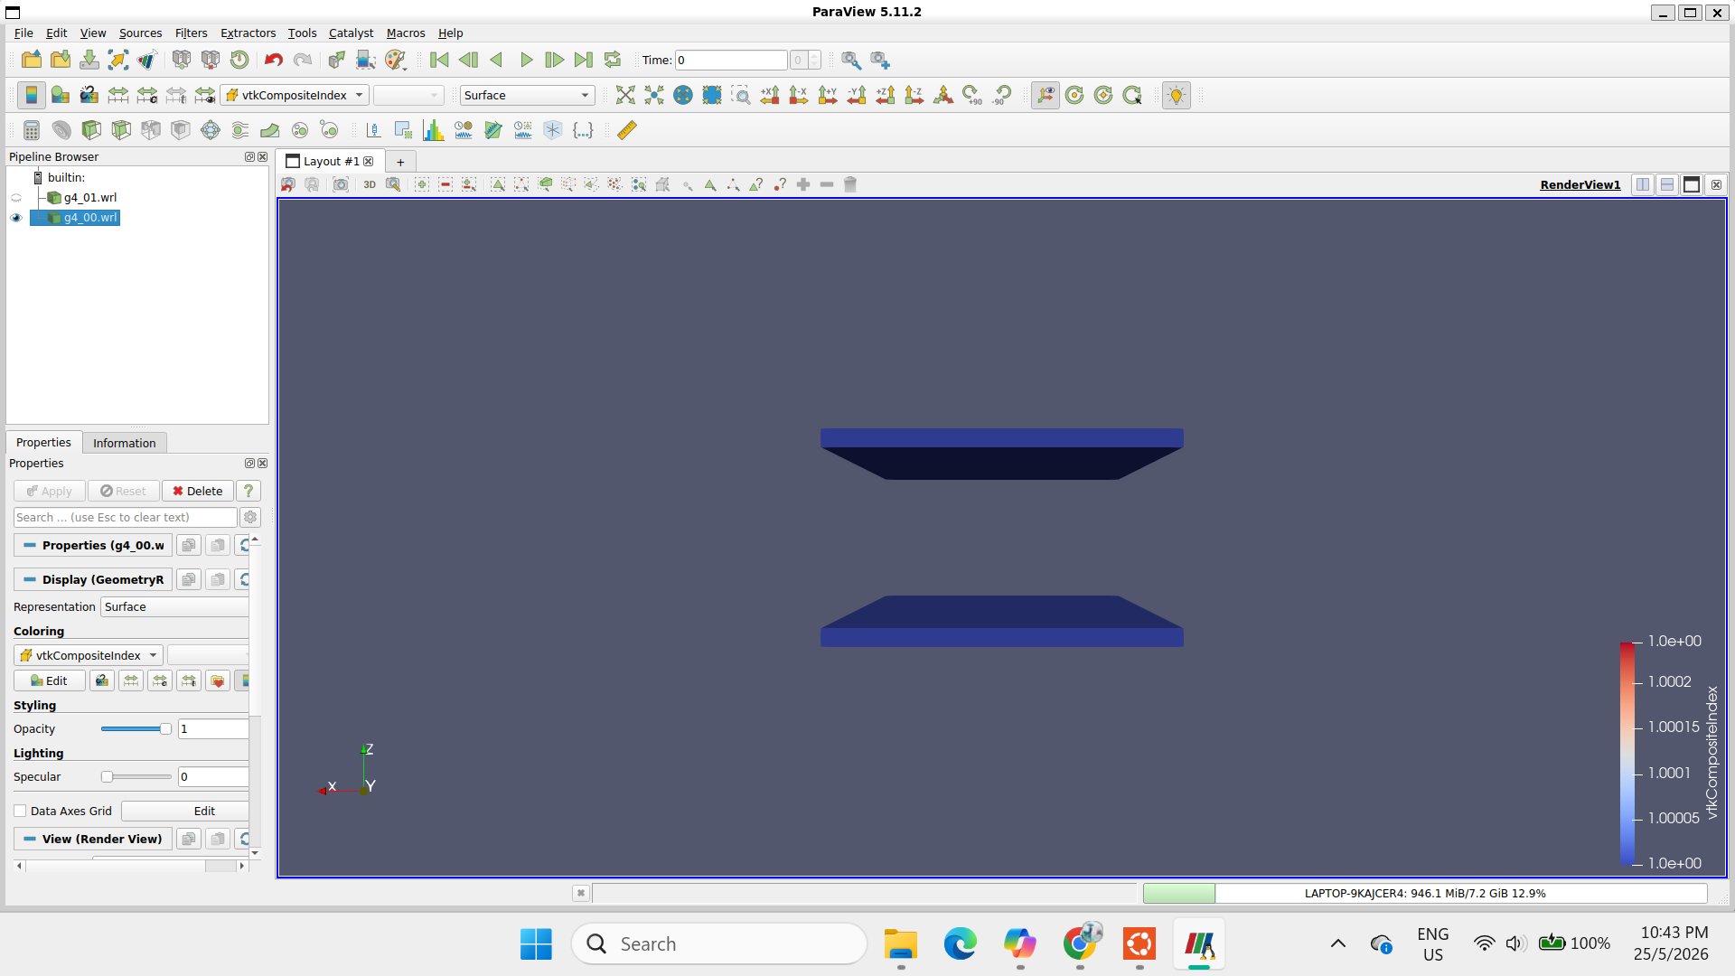
4
Method: Simulation
Subbox length
  Simulator: Geant4-based software is used.
  Generator: CRY muon generator
  Global parameters
    Altitude: 0m (sea level)
    Generate only muon
Height
20cm side
    Optimal parameters : statistics 2m events
    Relation between turning point and height derived
    Approximate turning point and only valid for specific detector geometry
D101
40cm side
Detector spacing : 10cm
D102

Slide 5
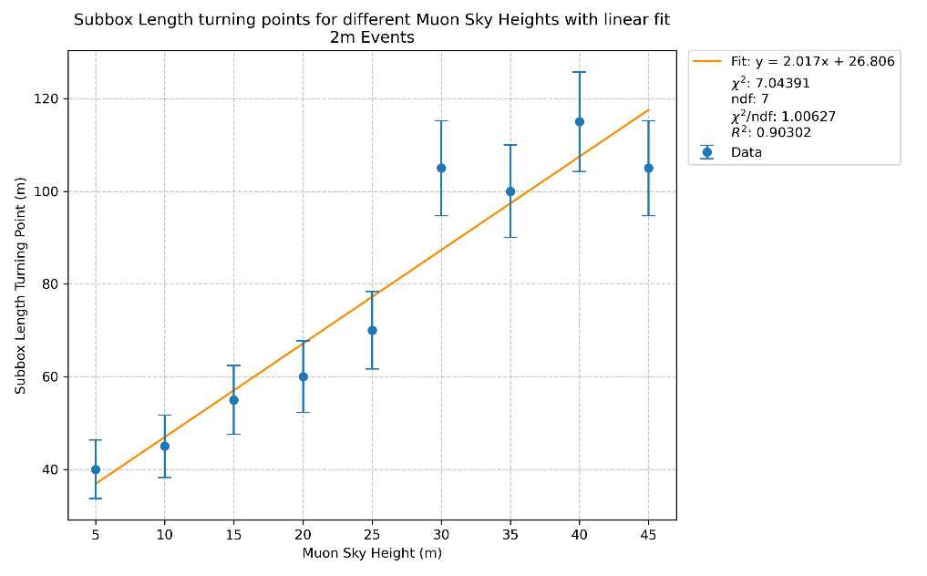
5
Method: Simulation
Relation between subbox turning point and muon sky height from previous parameter scan:
Turning point = 2.017(muon sky height) + 26.806
We can get the turning point for the respective muon height.
Efficiency of detectors = muons detected/muons released
Efficiency should be constant across the heights with the respective subbox length turning point for the same geometry

Slide 6
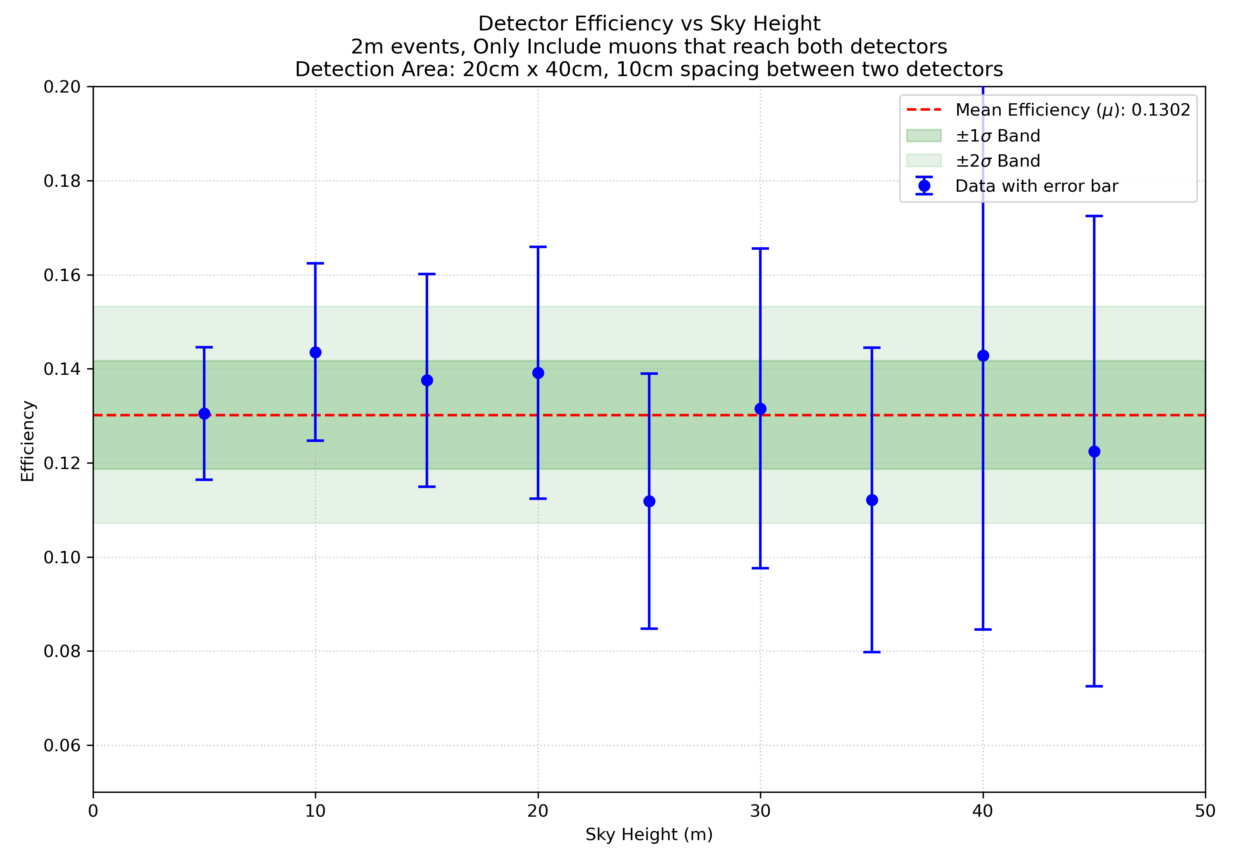
6
Results : Efficiency vs muon sky height
Efficiency for different height and subbox length is compatible within 2 sigma

Slide 7
7
Previous multiparameter scans reveals the relation of subbox length and height. The relation is specifically for 20cm*40cm*1cm detectors with 10cm spacing.
But…
The detector size depends on what detector we can get for actual experiments
What if we cannot get the exact size that is used for simulation?
Dr Hoh say the detector dimensions have to change to 50cm*50cm*1cm.
What to do?
This motivates the investigation for different detector geometries

Slide 8
8
Method: Simulation
50cm side
50cm side
50cm side
20cm side
50cm side
90cm side
50cm side
70cm side
50cm side
D101
D101
D101
D101
D101
D101
D101
D101
Detector spacing : 10cm
Detector spacing : 10cm
Detector spacing : 10cm
Detector spacing : 10cm
50cm side
Detector spacing : 10cm
50cm side
D101
40cm side
90cm side
70cm side
Increase detector spacing
**Using 50cm*50cm detection area
    Increase detector size
Detector spacing : 20cm
50cm side
Detector spacing : 30cm
D102
D102
D102
D102
D102
50cm side
Detector spacing : 40cm
50cm side
Detector spacing : 50cm
D102
50cm side
D102
40cm side
60cm side
80cm side
D101
D102
D101
D101
Detector spacing : 10cm
Detector spacing : 10cm
40cm side
Detector spacing : 10cm
D102
60cm side
80cm side
D102
D102
D102

Slide 9
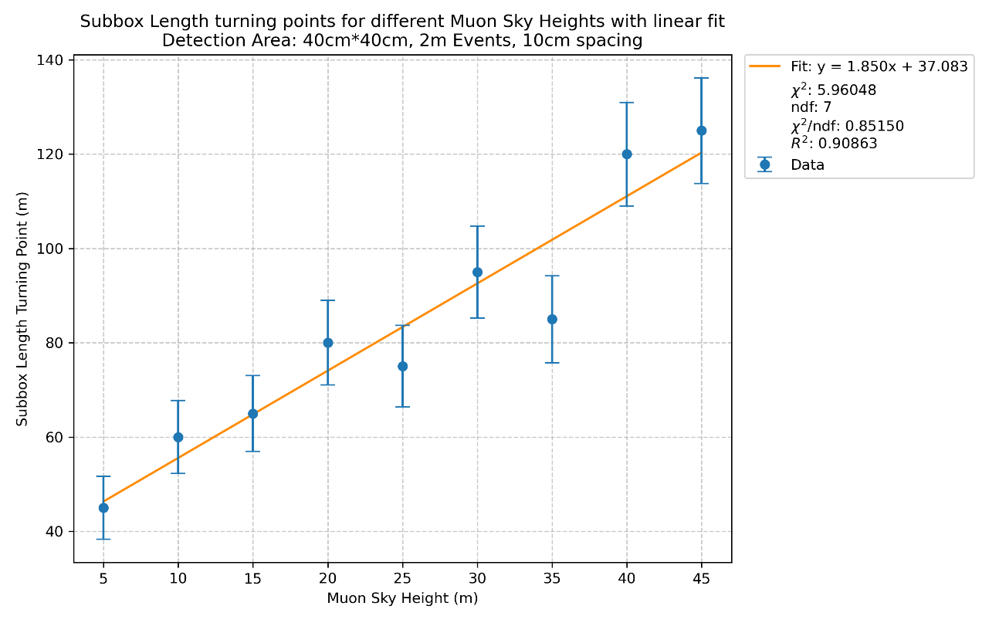
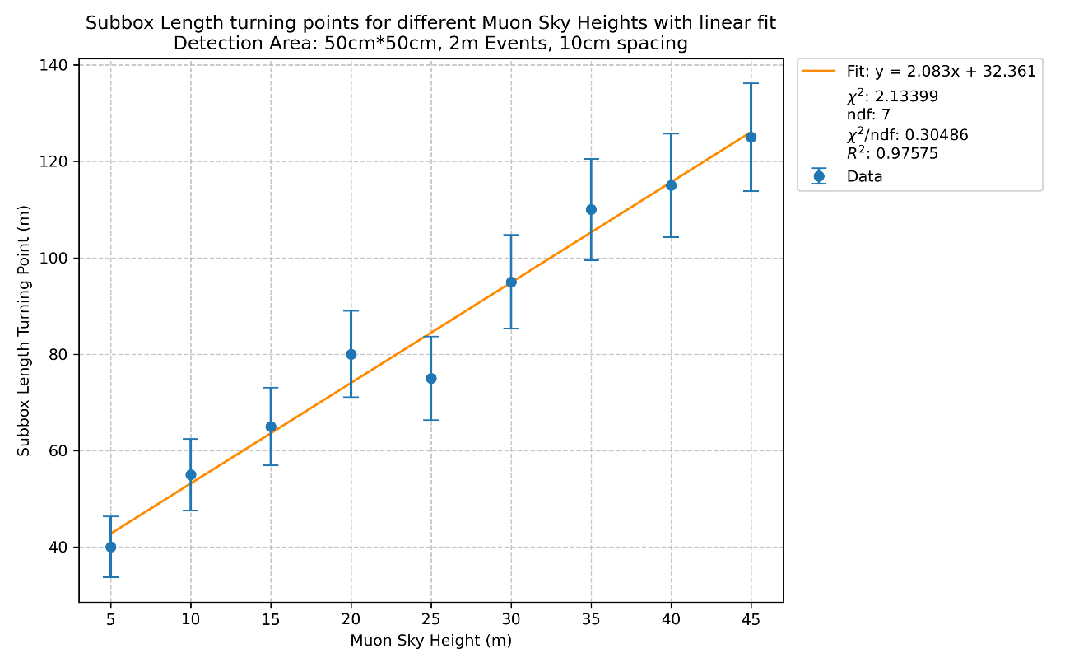
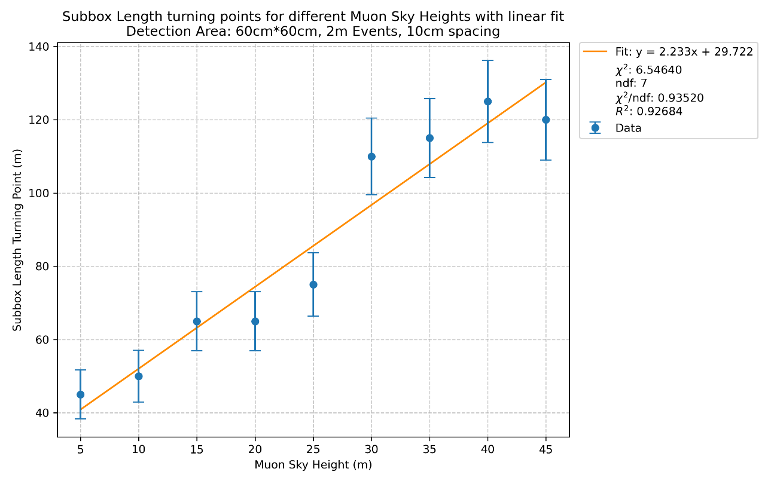
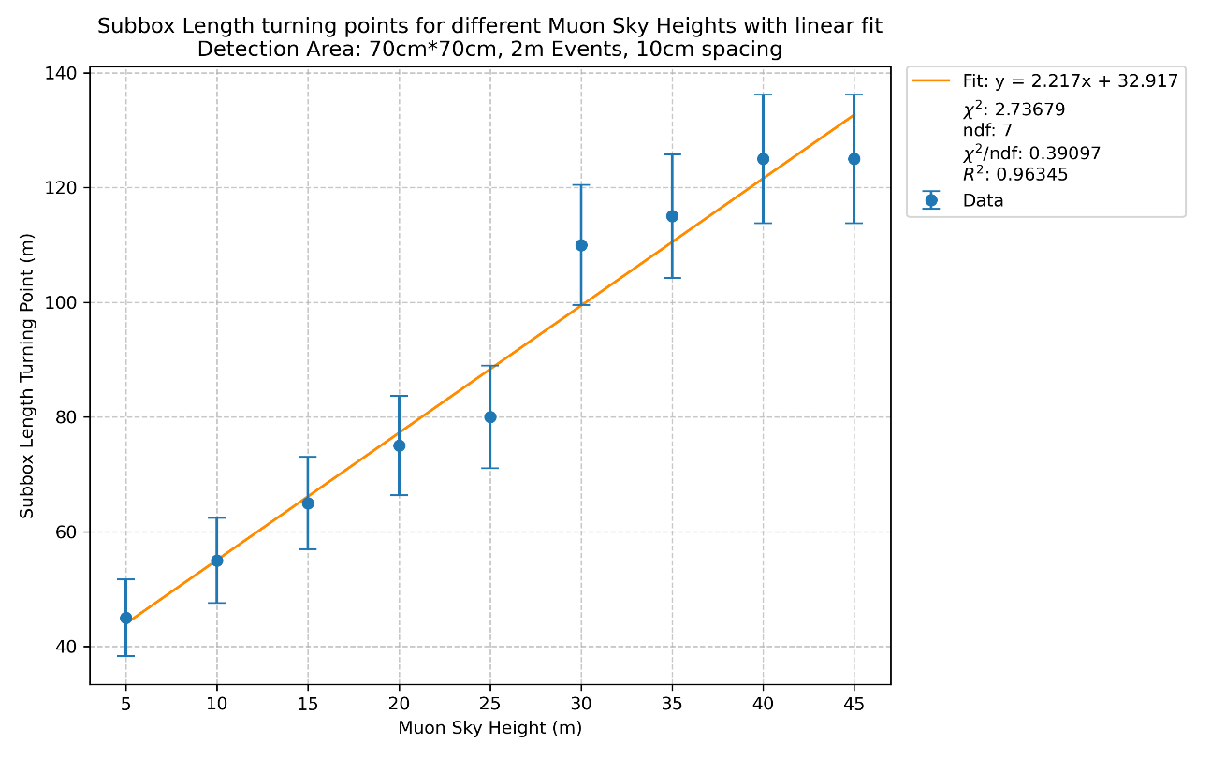
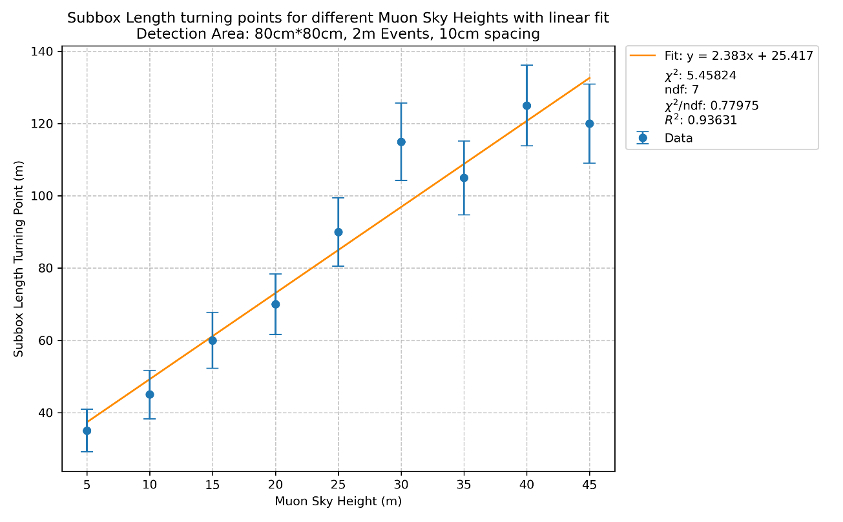
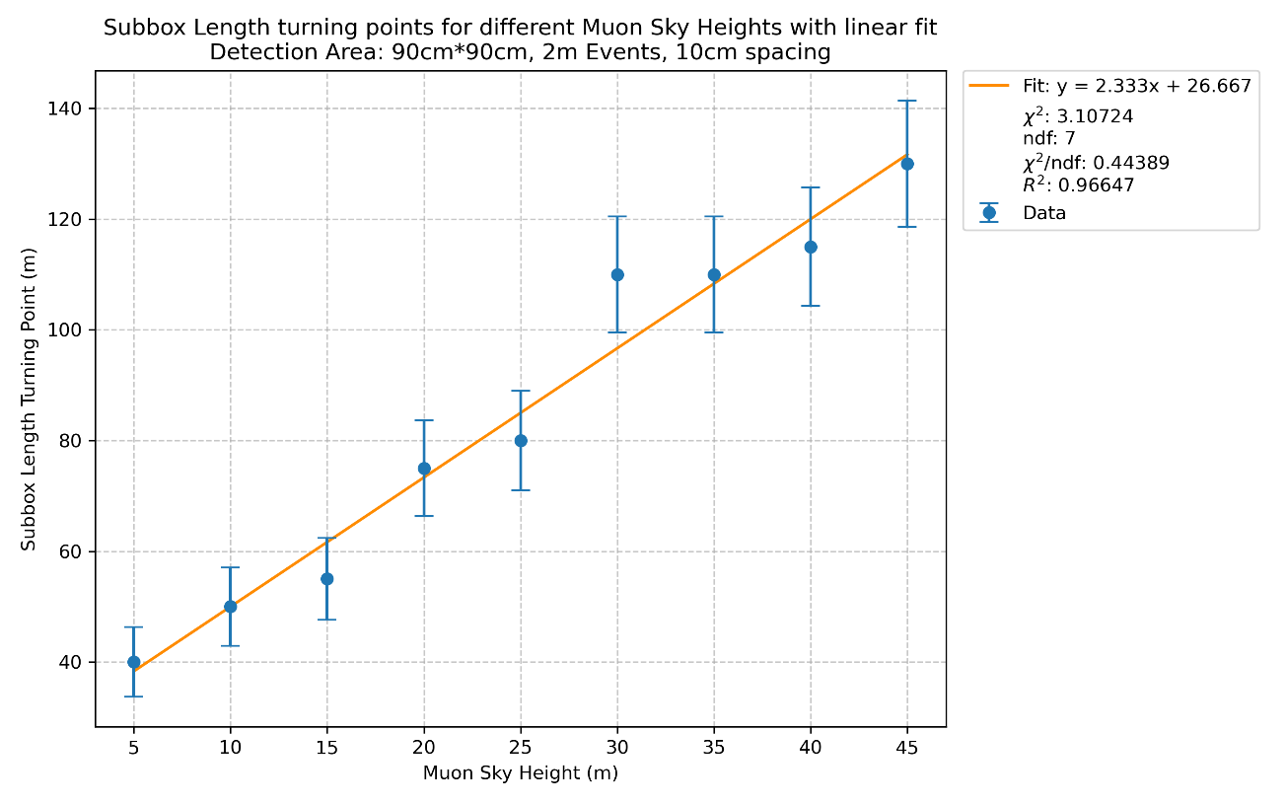
9
Results : Increase in detection area
40cm*40cm*1cm
50cm*50cm*1cm
60cm*60cm*1cm
Size to be used for further simulation as requested by Dr. Hoh
70cm*70cm*1cm
80cm*80cm*1cm
90cm*90cm*1cm

Slide 10
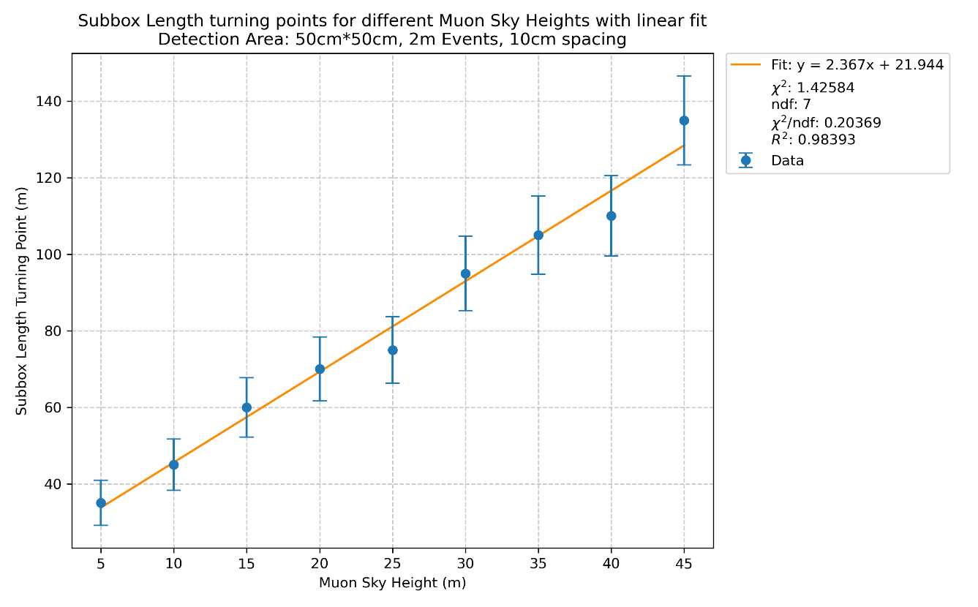
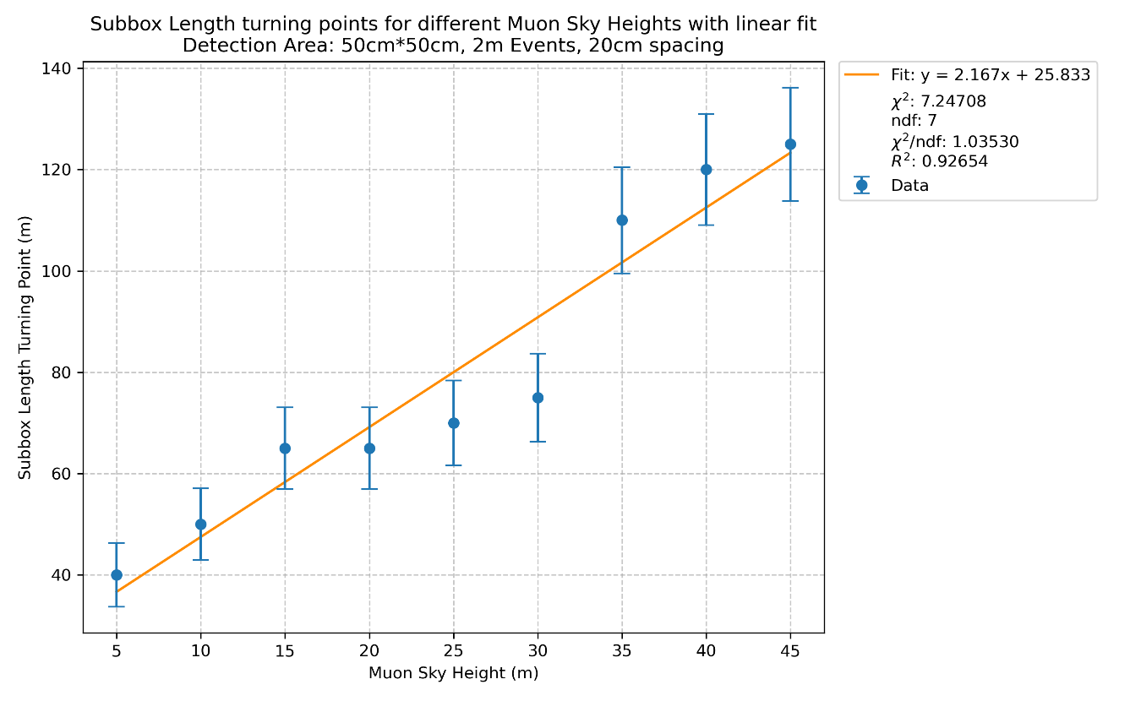
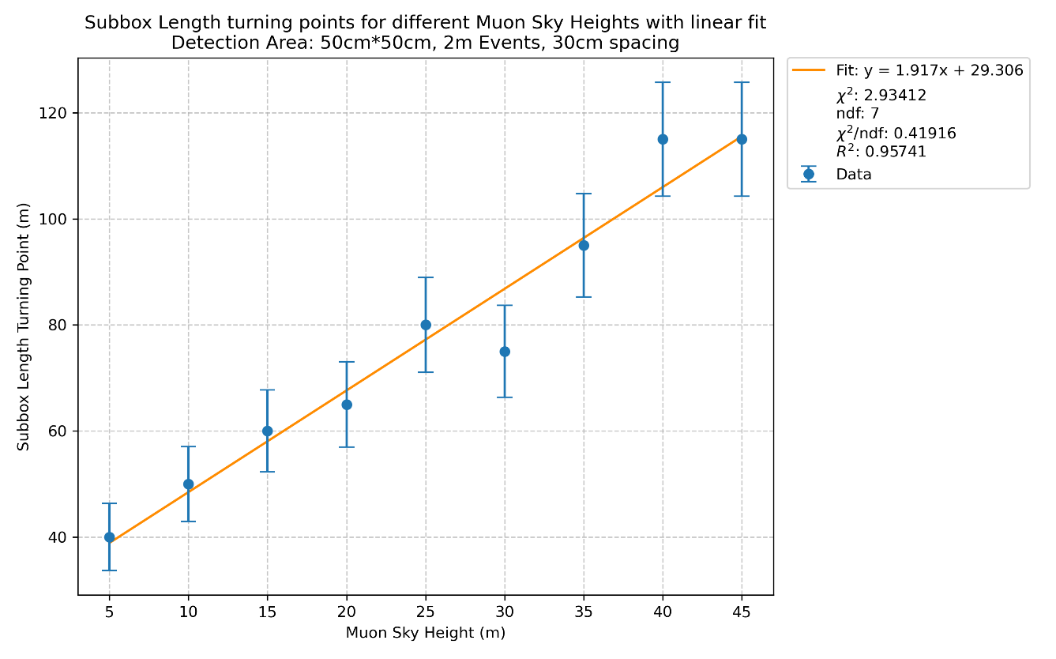
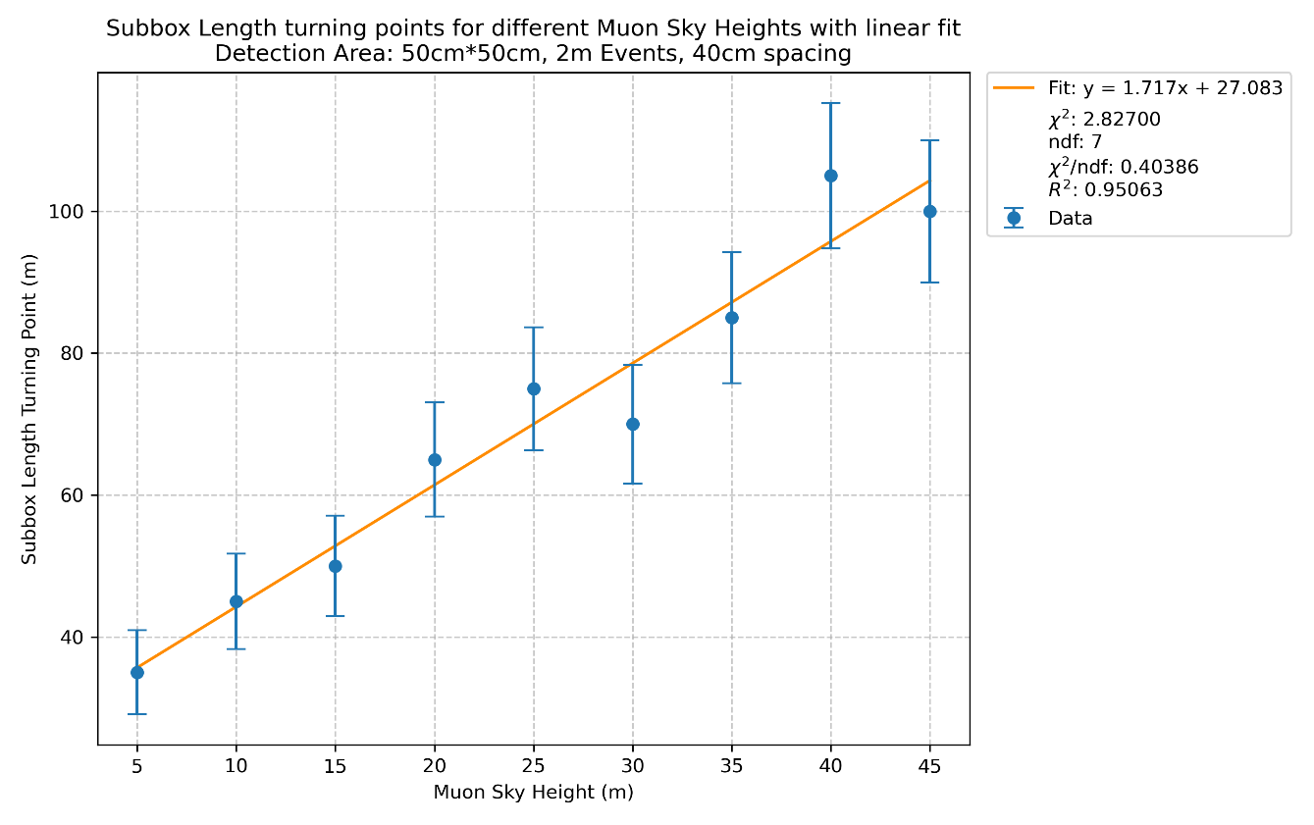
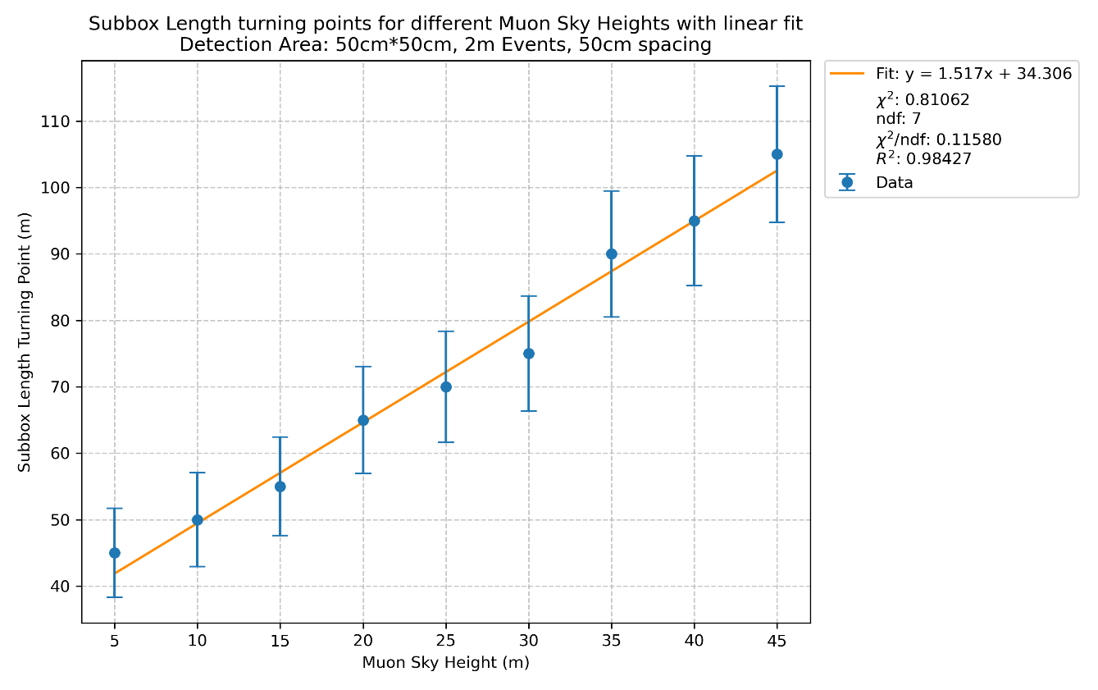
10
Results : Increase in Detector spacing
10cm
20cm
30cm
50cm*50cm*1cm detectors are used
40cm
50cm

Slide 11
11
Conclusion
    Optimal parameters (statistics, height, subbox length) = (2 million, 1m, 2(1)+26.8m)
    Efficiency for different height with its respective subbox length is compatible within 2 sigma
    Efficiency of two 20cm*40cm*1cm detectors with 10cm spacing is 0.1302
    Increase in detection area and detector spacing affects a little because the changes is too small comparing with the subbox length
  Caveats:
    Turning point is an approximate

Slide 12
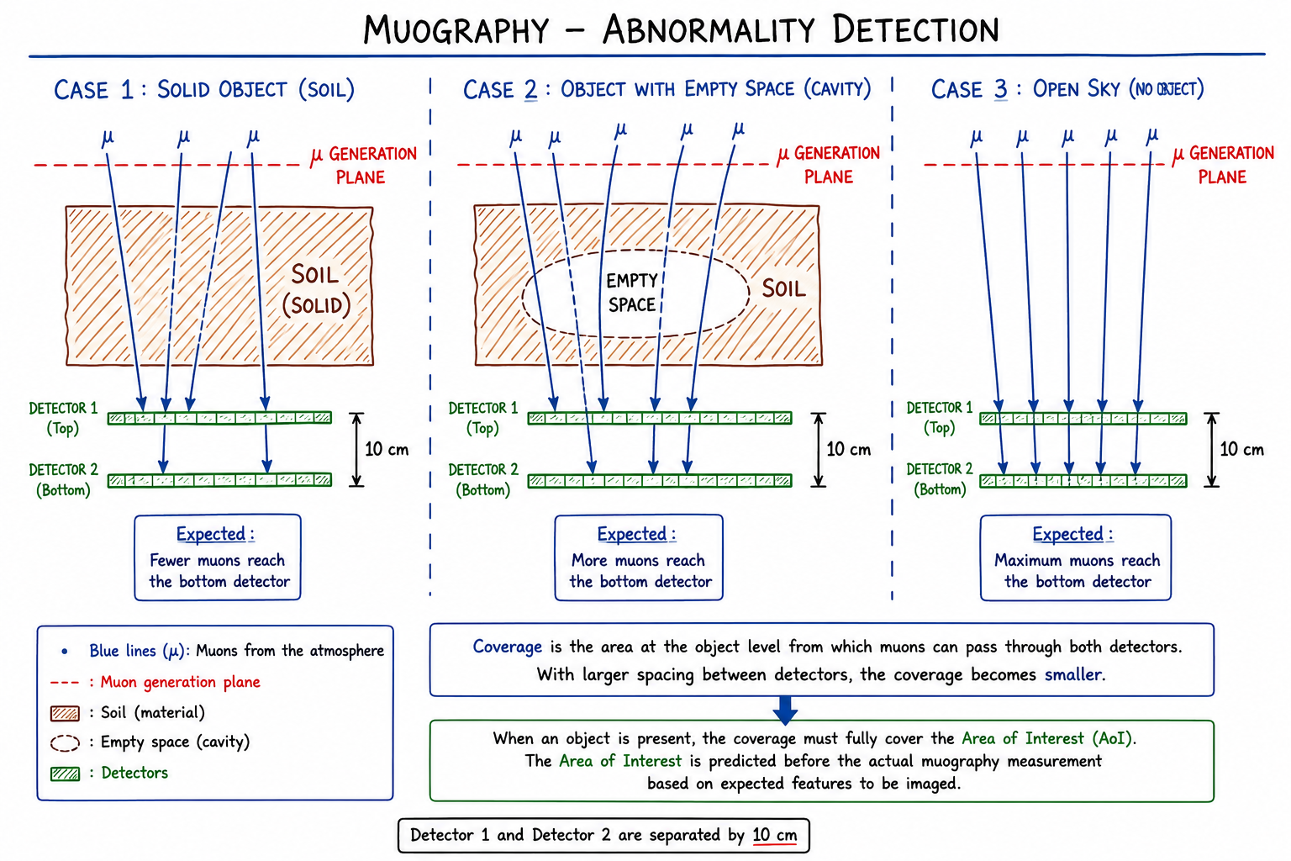
12
Next step
  Abnormality detection
Reference for solid object
Diagram not up to scale

Slide 13
14
THANK YOU

